Slide 1
Introduction to Open Web Tools MiniWorkshop
An interactive workshop on open source web tools to use in your simulation practice
August 7-9, 2017
Matthew Dahlhausen
Mostapha Sadeghipour Roudsari
Chris Mackey
Theo Armour

Slide 2
Outline:
Examples (25 min)
Mostapha :: epwmap
Matt :: epwvis
Chris :: Payette Thermal Comfort Tool
Theo :: ladybug-web
Workshop (40 min)
Choosing a language for your project
Closing & Questions (10 min)

Slide 3
Examples (25 min)
What was the goal of the tool?
Who do you imagine using it?
Which languages did you use, and why that language?
How long did it take, and what were some lessons learned?
What could you do to improve the tool?

Slide 4
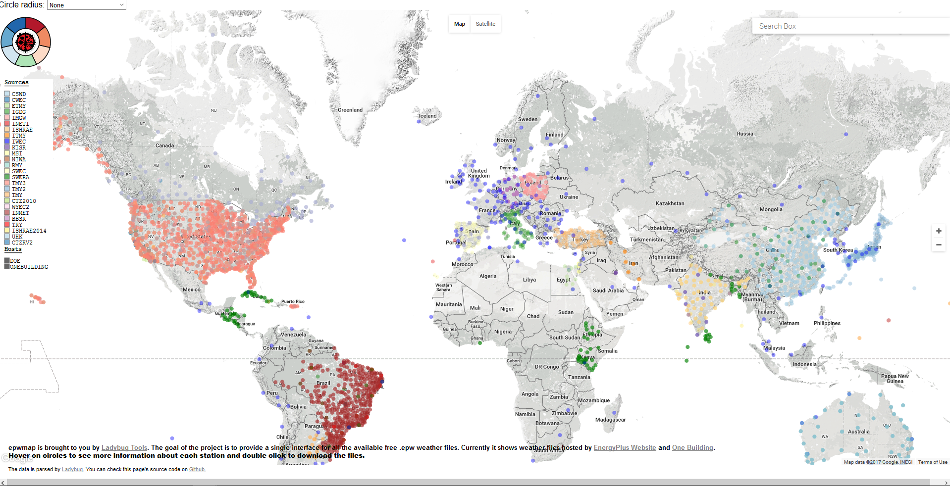
epwmap
ladybug.tools/epwmap
d3.js, google maps

Slide 5
epwvis
An online viewer and analysis tool for EnergyPlus Weather (EPW) files

Slide 6
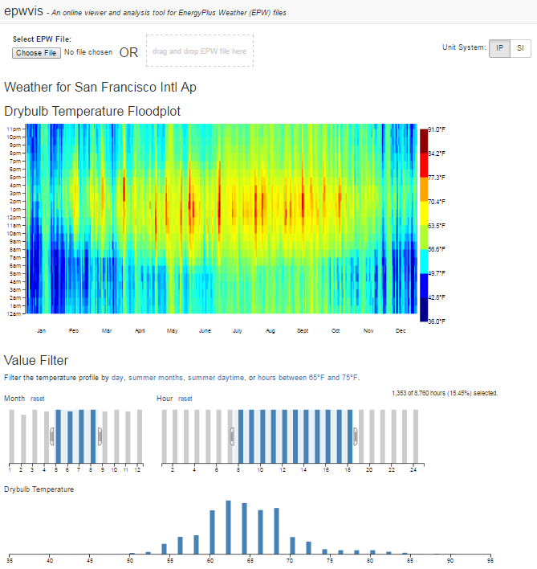
epwvis
https://mdahlhausen.github.io/epwvis/
d3.js

Slide 7
epwvis
Motivation:
Lots tools that will give fixed graphics for a particular place
I wanted to be able to do quick analysis without a spreadsheet
For simple questions:
- how many hours per year can I do waterside economizing?
- what is a typical temperature range during occupied hours in summer?
Drag & Drop
Analysis

Slide 8
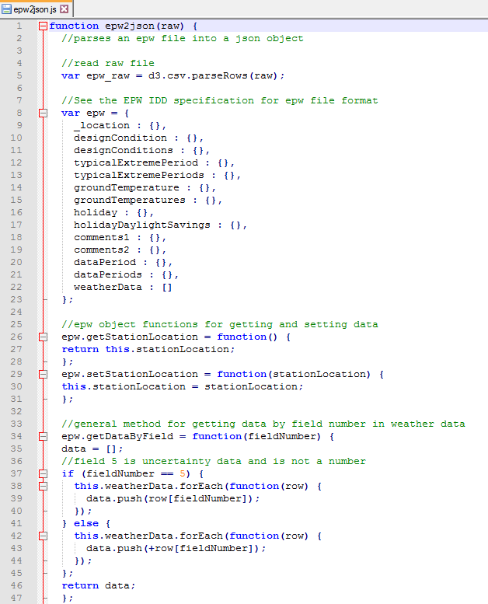
epwvis
Picked javascript / d3.js because:
(1) browser based (anyone can use)
(2) interaction
(3) low-level graphics for control
Steps broken down:
Parse .epw file with javascript
Setup page layout
Add basic floodplot (proof of data import)
Add SI/IP units conversions
Add crossfilter analysis
Add Windrose

Slide 9
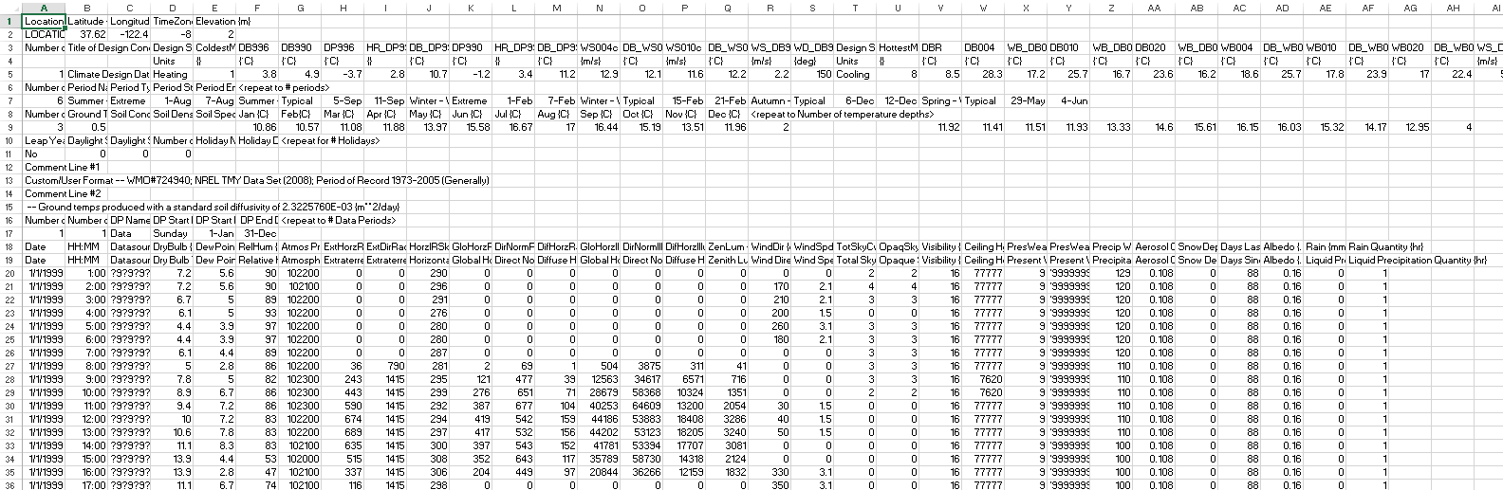
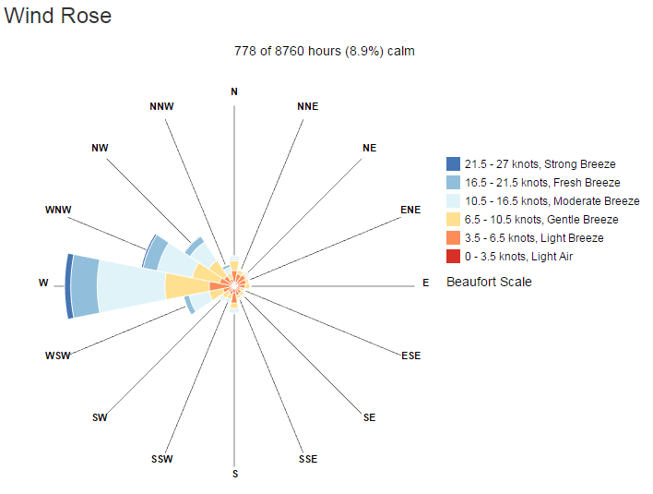
epwvis
↑ Convert this
Into this →
Notes:
Data parsing

Slide 10
epwvis
Lessons Learned:
Web languages often library dependencies – need to trade-off using libraries vs. keeping page simple and lean
Need to think a bit about data parsing – minimal steps to go fast
Organize structure from the beginning to save time later repeated tasks. E.g., each type of graph is a function, pass parameters to it.
Having live-feedback is very useful for speed. It WON’T work the first time.
Future:
More analysis, filtering, graph options, save to image, custom layouts

Slide 11
Glazing and Thermal Comfort Tool
A tool to eliminate perimeter heat in the building industry

Slide 12
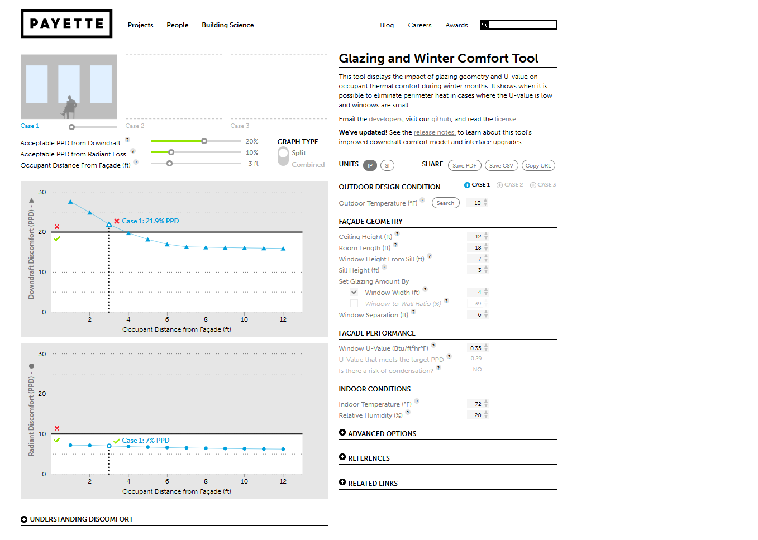
Glazing and Winter Comfort Tool
http://www.payette.com/building-science/glazing-and-winter-comfort-tool
d3.js, bootstrap

Slide 13

PERIMETER HEAT

Slide 14
PERIMETER HEAT
If this were well insulated

Slide 15
PERIMETER HEAT
If this were well insulated
We wouldn’t need this

Slide 16
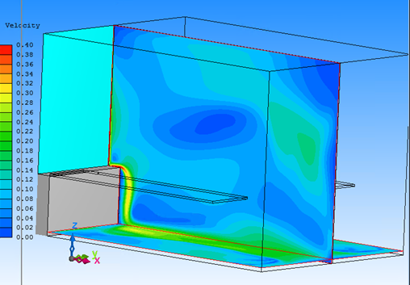
PERIMETER HEAT
If this were well insulated
$10,000 CFD Simulation
That took 2 weeks
Found comfortable conditions with triple pane
We wouldn’t need this

Slide 17
PERIMETER HEAT
If this were well insulated
We wouldn’t need this
 | Cost/ft² Window
Upgrade Double to Triple Pane | $5.47
Add Perimeter Heat to Double | $53.20

Slide 18
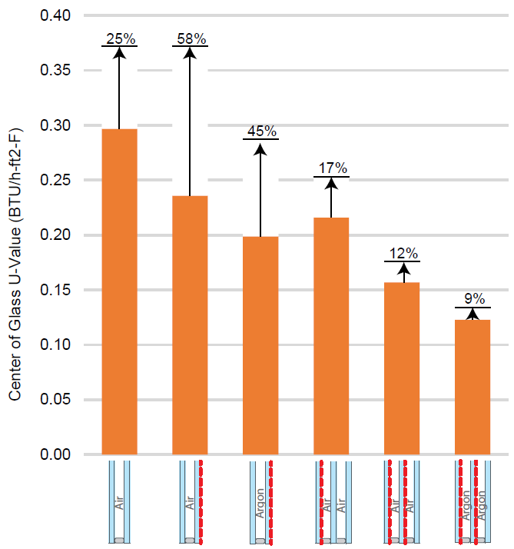
PERIMETER HEAT
Degrading your Window U-Value by Heating the Inner Surface

Slide 19
CAUSES OF WINTER DISCOMFORT

Slide 20
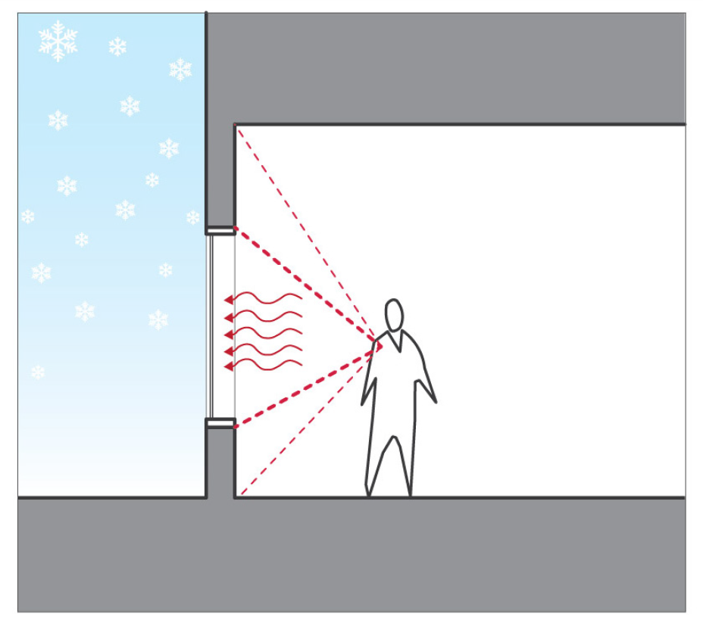
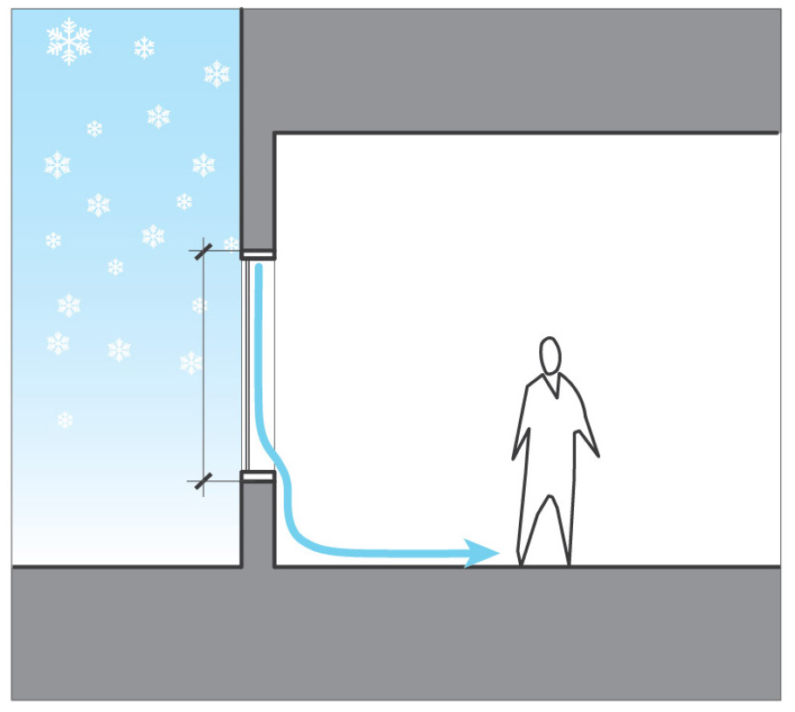
CAUSES OF WINTER DISCOMFORT
Radiant Discomfort
(Full-body Discomfort)
Draft Discomfort
(Ankle Discomfort)

Slide 21
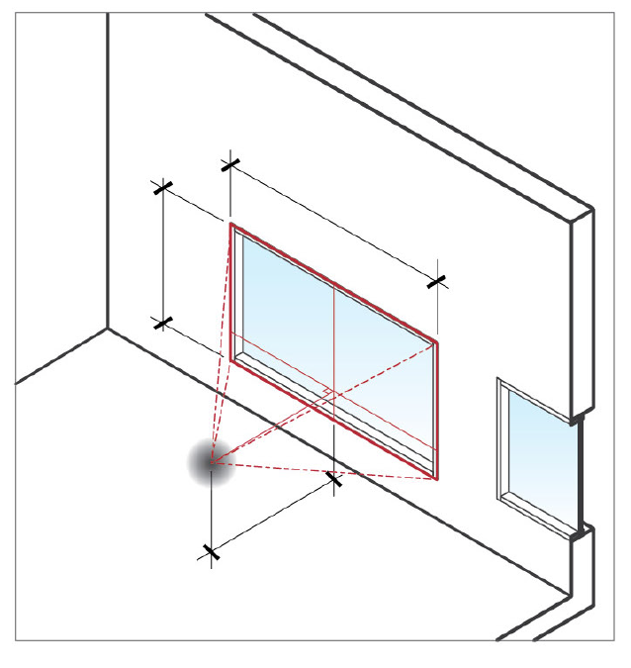
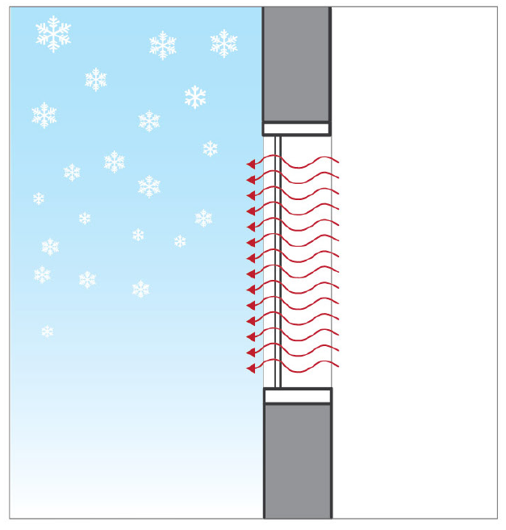
CAUSES OF WINTER DISCOMFORT
Causes
Window
View Factor
Window Temperature
(U-Value)
Radiant Discomfort
(Full-body Discomfort)

Slide 22
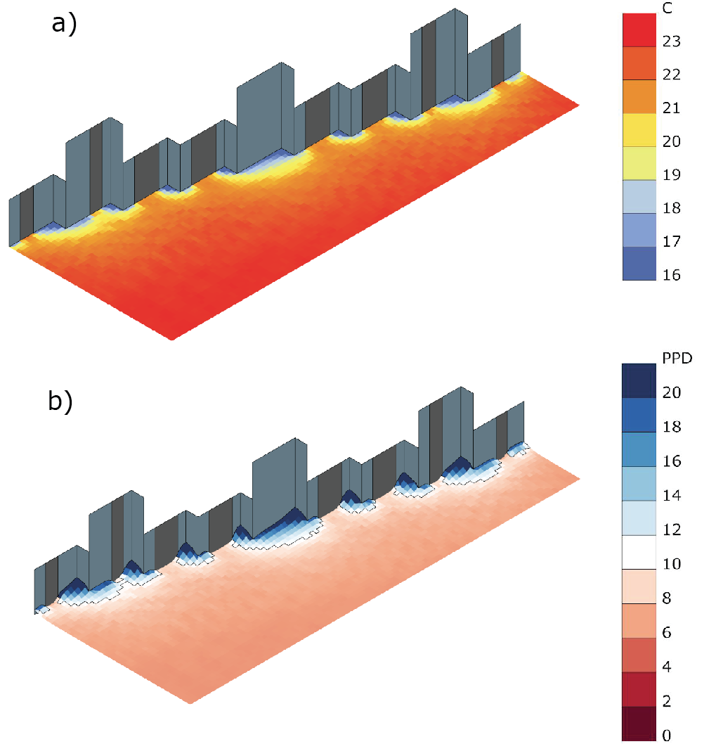
CAUSES OF WINTER DISCOMFORT
Radiant Discomfort
(Full-body Discomfort)

Slide 23
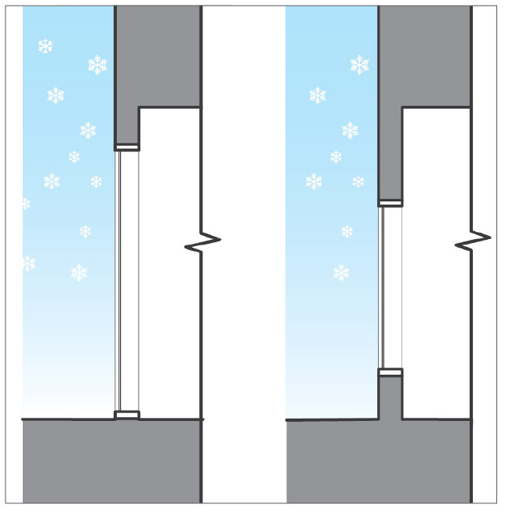
CAUSES OF WINTER DISCOMFORT
Causes
Window
Height
Window Temperature
(U-Value)
Draft Discomfort
(Ankle Discomfort)

Slide 24
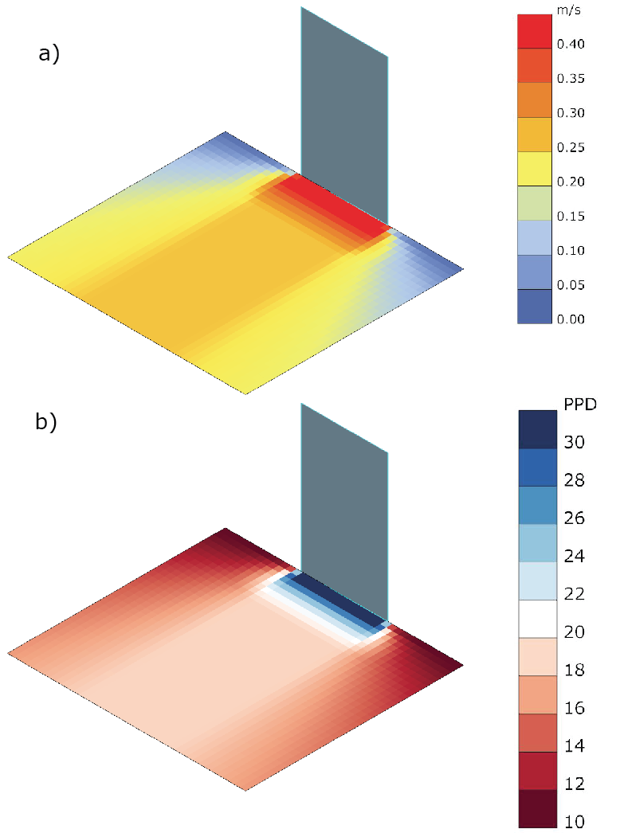
CAUSES OF WINTER DISCOMFORT
Draft Discomfort
(Ankle Discomfort)

Slide 25
EVOLUTION OF A TOOL

Slide 26
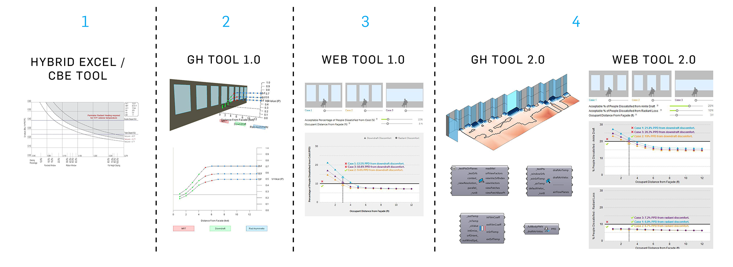
EVOLUTION OF A TOOL

Slide 27
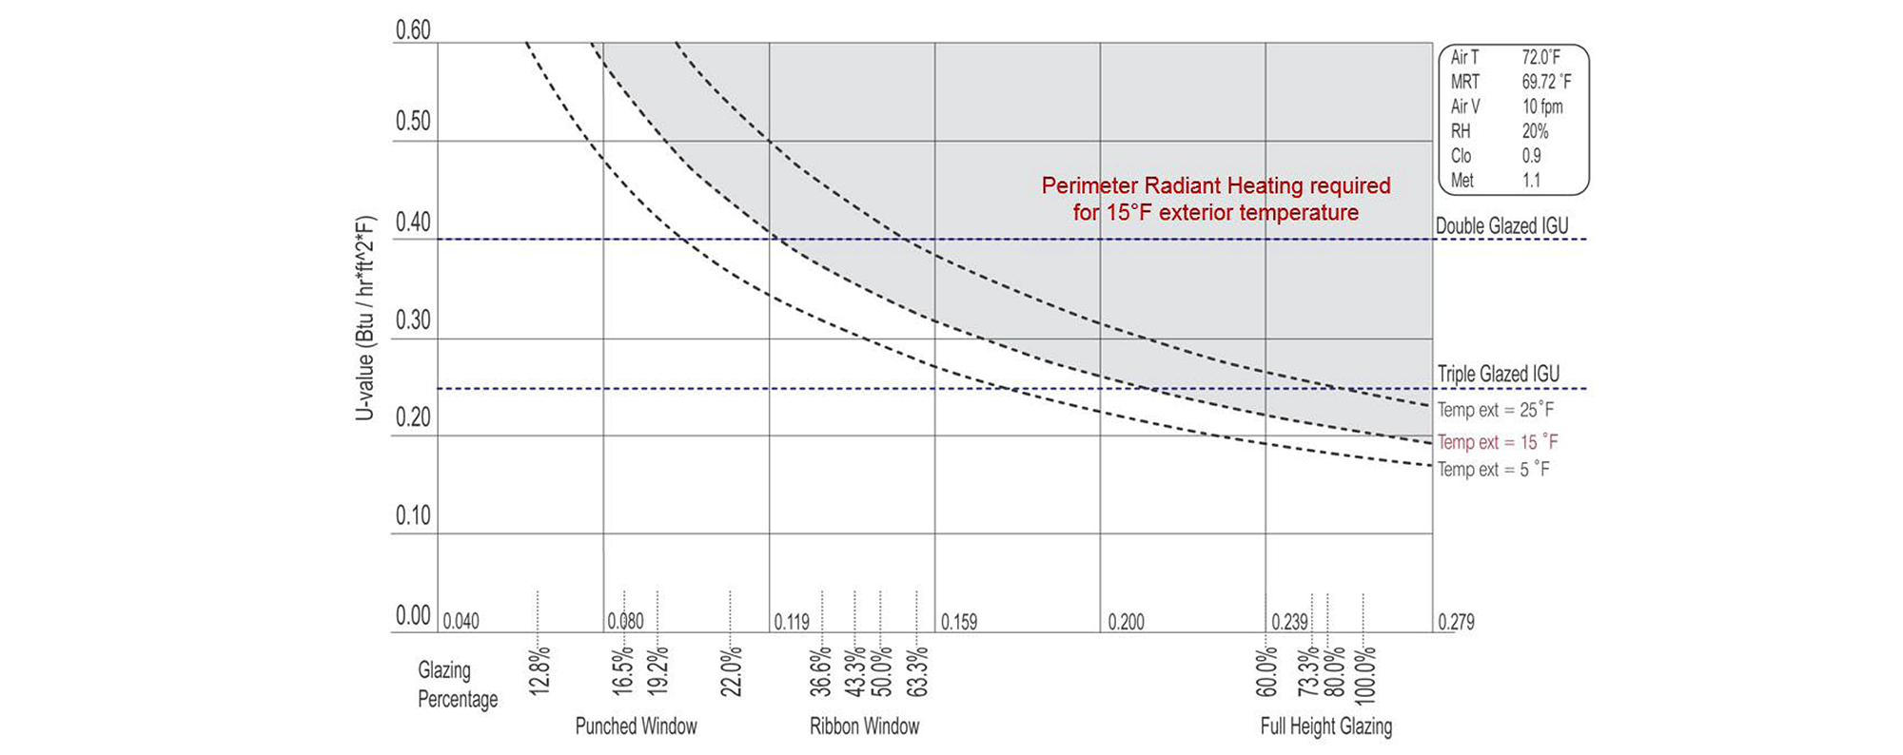
EVOLUTION OF A TOOL
Hybrid Excel / CBE Tool

Slide 28
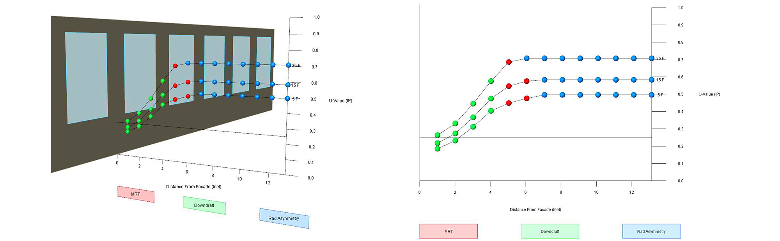
EVOLUTION OF A TOOL
Grasshopper Tool 1.0

Slide 29
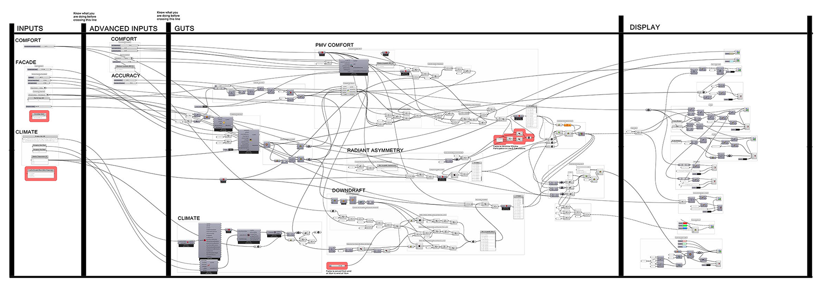
EVOLUTION OF A TOOL
Grasshopper Tool 1.0

Slide 30
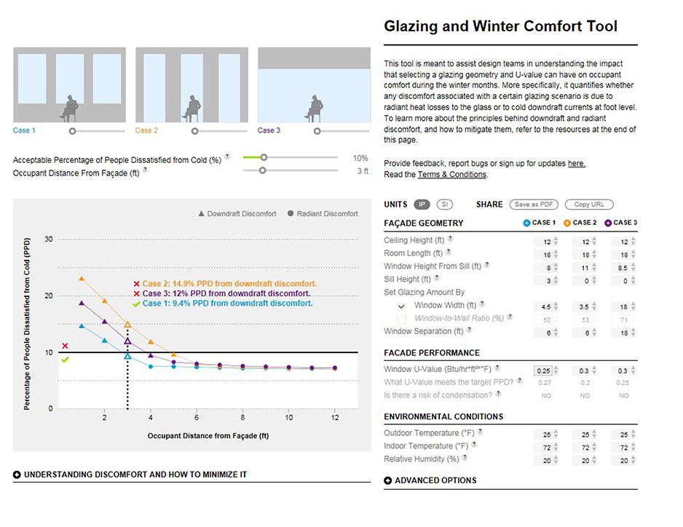
EVOLUTION OF A TOOL
Web Tool 1.0

Slide 31
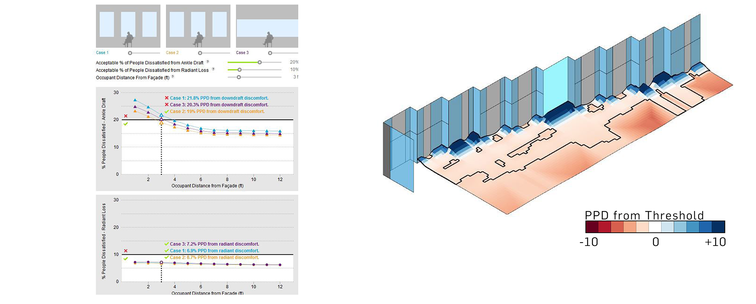
EVOLUTION OF A TOOL
Fast, Simple Web Tool
Slower, Advanced Grasshopper Tool

Slide 32
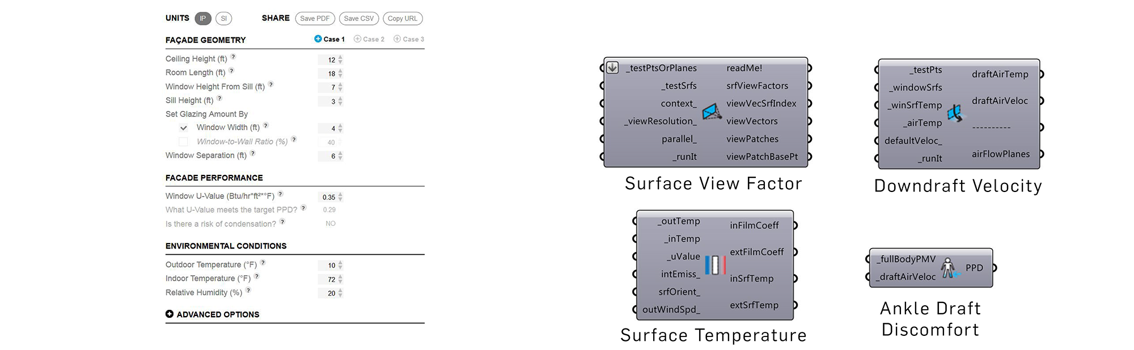
EVOLUTION OF A TOOL
Form Inputs + Buttons
Component-Based Inputs Accepting a Wide Range of Data Types

Slide 33
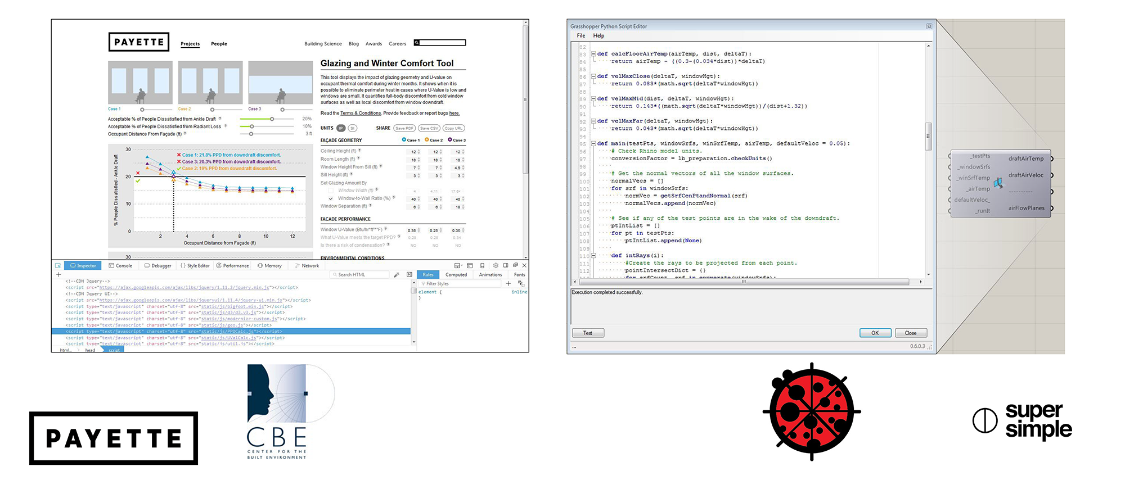
EVOLUTION OF A TOOL
Open Source Javascript
Open Source Python

Slide 34
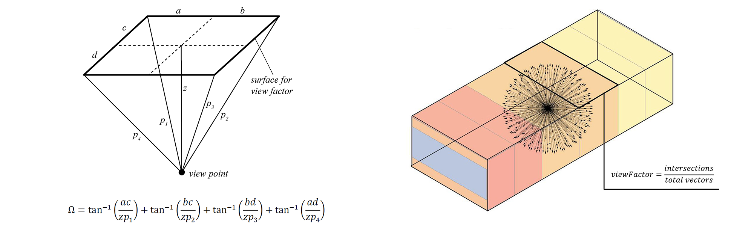
EVOLUTION OF A TOOL
Fast Calculations for Orthogonal Geometry
Slower Calculations for All Geometry

Slide 35
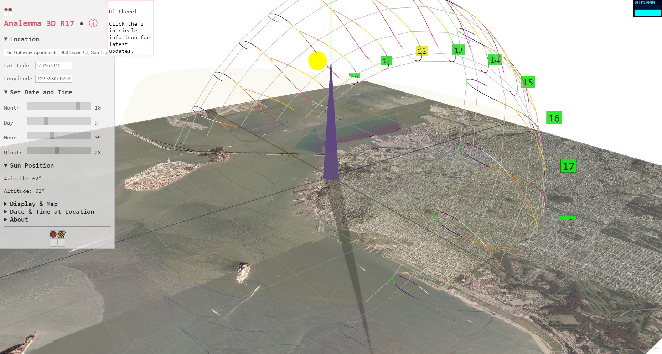
ladybug web tools
http://www.ladybug.tools/ladybug-web/analemma-3d/analemma-3d-r18.html
three.js, google maps

Slide 36
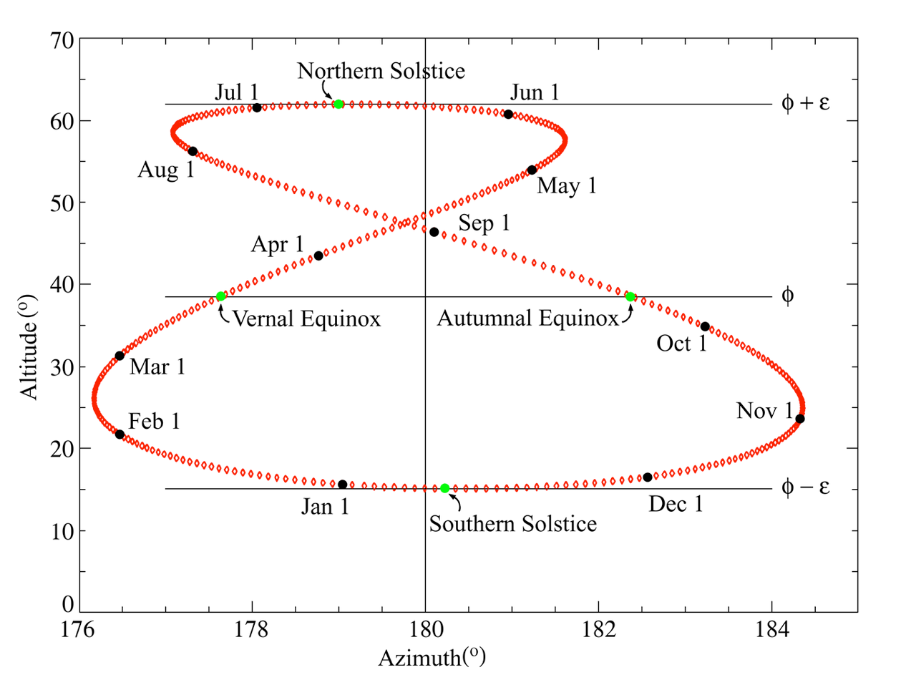
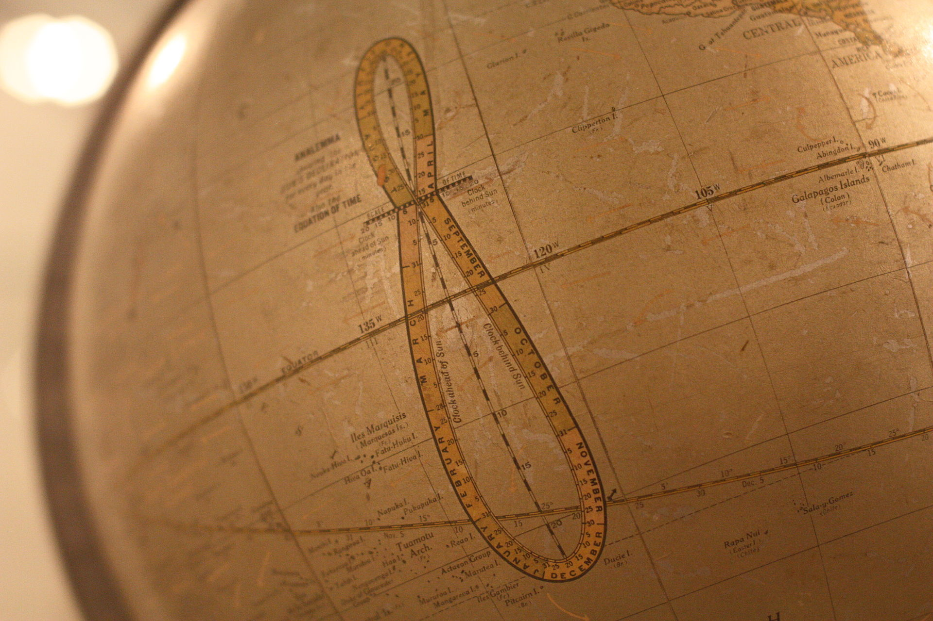
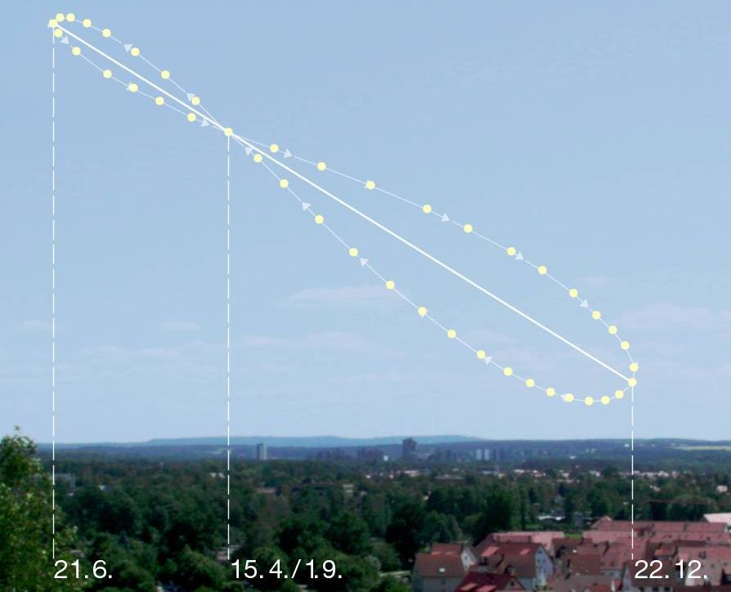
A Dilemma of Analemmas
Bring daily Sun path calculations anywhere in the world down to a human - ie your - level and then display results in interactive 3D in your browser -- all free and open source
Notes:
An Analemma is a diagram showing the motion of the Sun in the sky, as viewed from a fixed location on the Earth.
If you can calculate the analemma for any location on earth then you can derive many useful calculations helpful in the building simulations.
The objective of this presentation is to show you that it gets easier and easier to create analemmas.
In turn this means we can get the effort out of the brains of mathematicians and programmers and into the hands of peeps like you
So you can create innovative applications for this knowledge

Slide 37
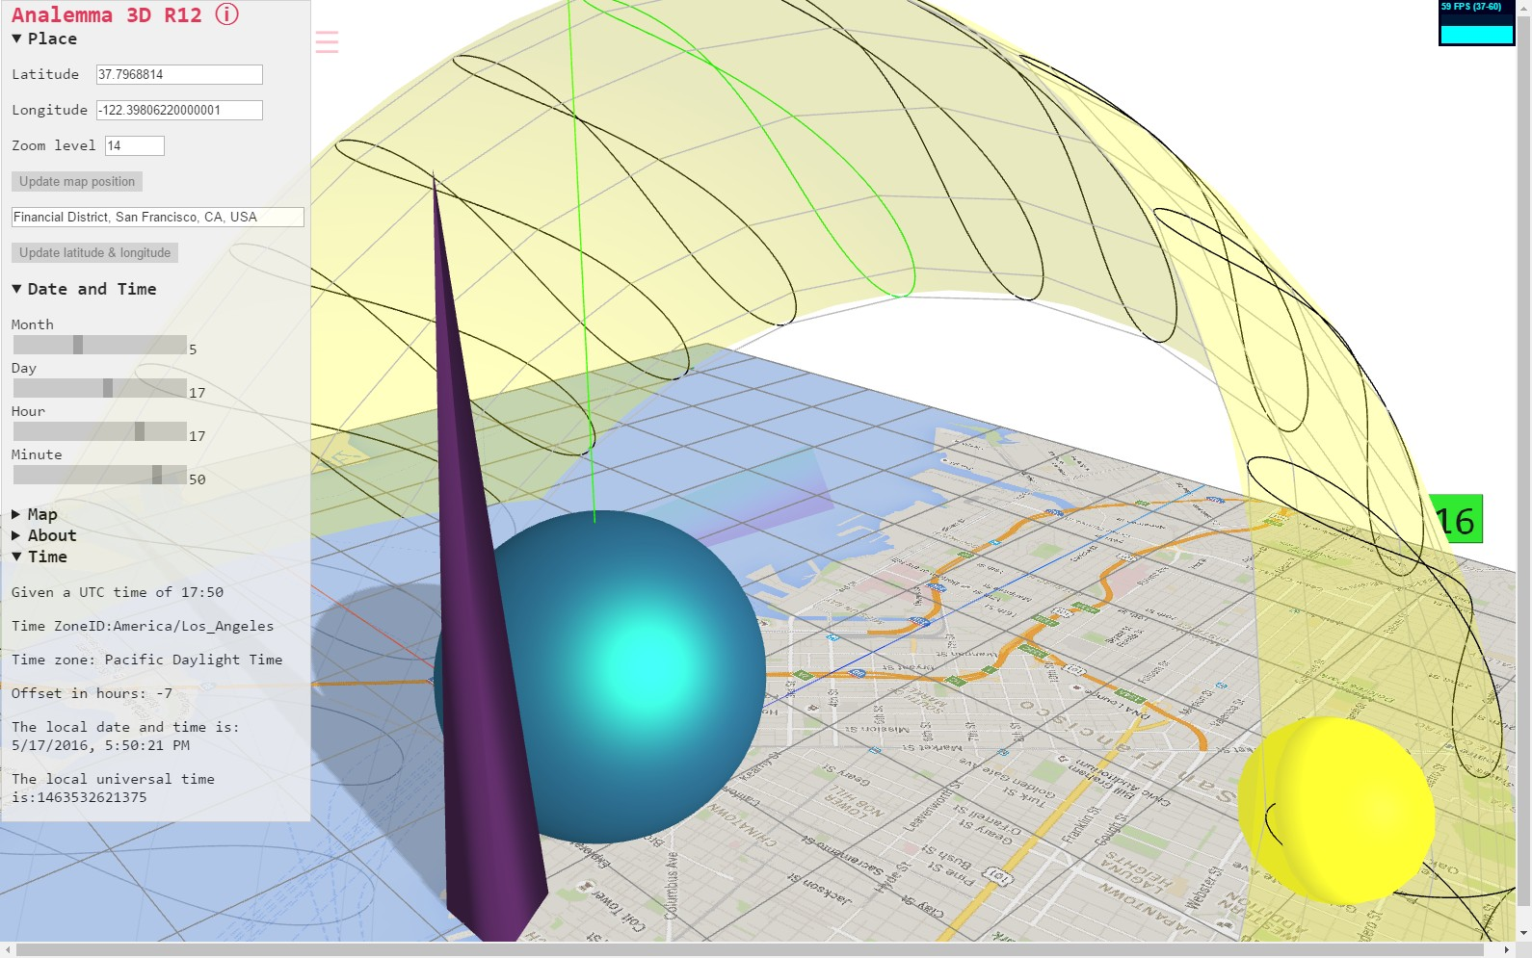
Want this - fast, easy, simple
Notes:
Show live example if possible

Slide 38
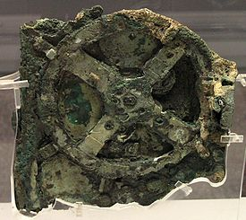
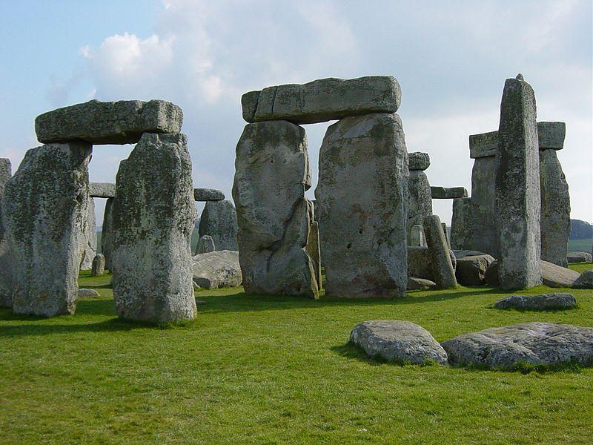
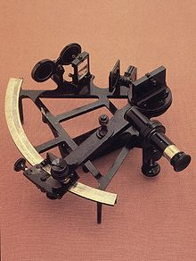
Where is the Sun going to be?
Perhaps the oldest science/math question there is...
Antikythera Mechanism
Greek analog computer 100 BC
Stonehenge
aligned to winter solstice sunset
Sextant
Find angle between 2 objects
Notes:
Calculating the position of the sun in the future is one of - if not the - oldest STEM questions in existence
Three examples you probably already know about:
Antikythera Mechanism - an orrery used to predict astronomical positions and eclipses for calendrical and astrological purposes
Stonehenge - long studied for its connections with ancient astronomy. The site is aligned in the direction of the sunrise of the summer solstice and the sunset of the winter solstice.
Sextant - The angle and the time when measured used to calculate a position line on a chart - for example, sighting the Sun at noon to estimate latitude
Today we can put these devices aside because of our laptops and phones

Slide 39
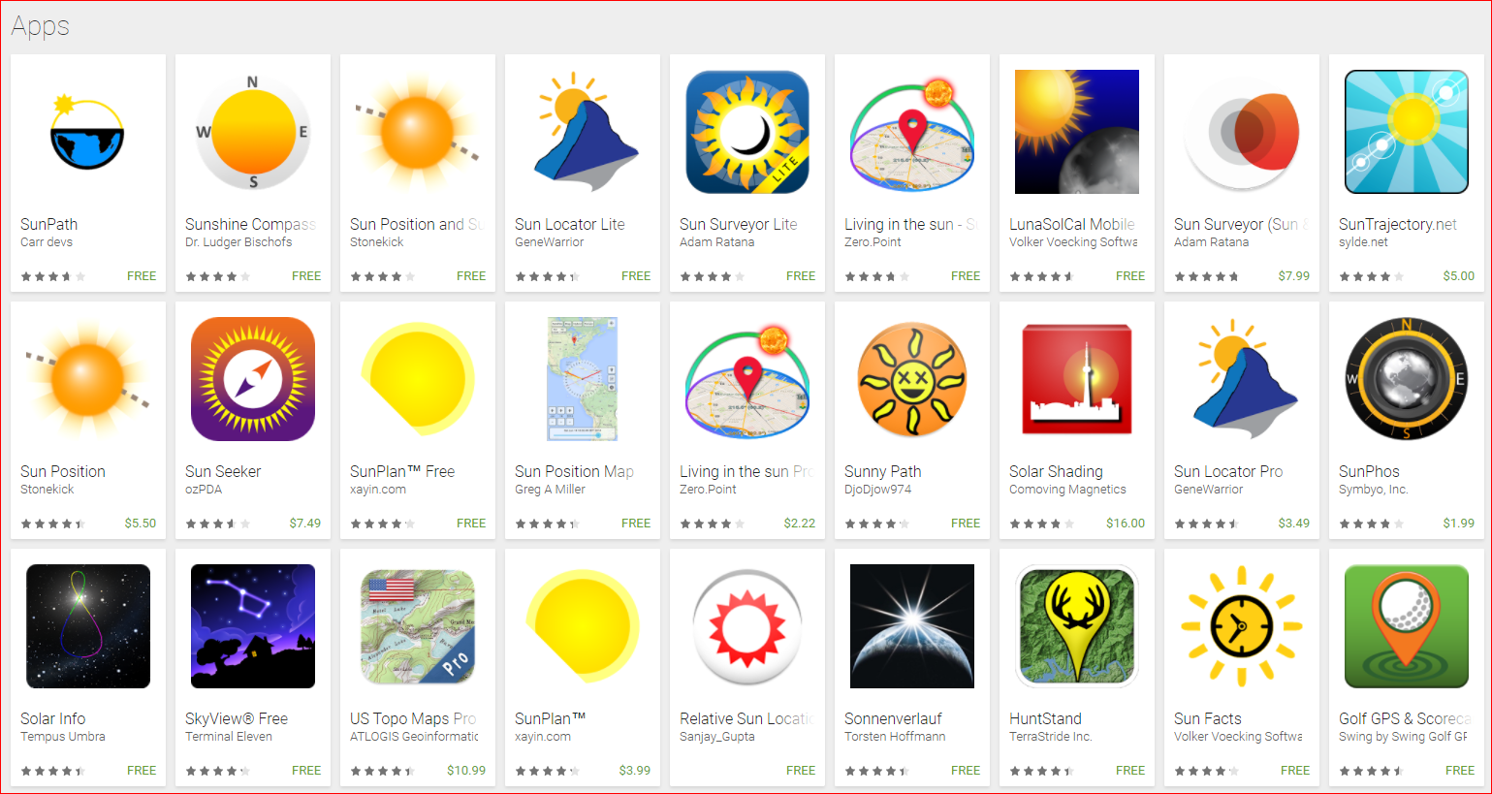
Today Sun position is an app
Many fun apps - mostly closed source, unverifiable and with little data sharing
Notes:
Today finding the position of the Sun is child’s play
Many apps out there.
Difficult if not impossible to see the source code - to verify the accuracy or quality of the code
Little or no way to import and export data
Looking for free open source tools

Slide 40
Source code: lots of it
You can calculate Solar path - in just about any language under the Sun
We want more - and want it free and open source:
To provide you with the position of the Sun - the azimuth ( apparent longitude ) and altitude ( apparent latitude ) - quickly and easily
Given the latitude, longitude, data and time
Usable in any number of ways
Code that is readable by people with little programming experience
Code that is readable by people with little astronomy experience
Code that is readable by people with little experience of Euler notation
Output in interactive 3D | Share data with other apps
Notes:
There’s source code for calculating Sun path in C, Basic, Fortran, Python, Swift - whatever
Yada Yada
But interactive, client-side 3D kind of limits you to JavaScript

Slide 41
Looked at 3 JavaScript scripts
Half dozen code bases out there. Three looked at closely
Vladimir Agafonkin - SunCalc.js
Mike Bostock - Solar Calculator
National Oceanic and Atmospheric Administration (NOAA) - Solar Calculator
All good but all have issues
Notes:
In 2016 we looked a good number JavaScript code bases
We discarded any code that is only available in a minified version or not FOSS
This includes http://andrewmarsh.com/apps/releases/sunpath3d.html

Slide 42
Agafonkin: SunCalc.js
function solarMeanAnomaly(d) { return rad * (357.5291 + 0.98560028 * d); }
function eclipticLongitude(M) {
var
C = rad * (1.9148 * sin(M) + 0.02 * sin(2 * M) + 0.0003 * sin(3 * M)),//equation of center
P = rad * 102.9372; // perihelion of the Earth
return M + C + P + PI;
}
Many excellent features but
Least descriptive variables, Issues with use of UTC time
Least accurate by a long shot

Slide 43
Bostock: Solar Calculator
(function() {
var J2000 = Date.UTC(2000, 0, 1, 12),
π = Math.PI,
τ = 2 * π,
radians = π / 180,
degrees = 180 / π;
Based on NOAA calculator
External dependency: on D3.js
Uses UTF-8 encoding - which is nice - but then embeds Greek characters - which is also cool - but very difficult to work with
Notes:
If your text editor is not set up for UTF-8, the characters appear as boxes

Slide 44
NOAA: Solar Calculator
function calcAzEl(output, T, localtime, latitude, longitude, zone) { var eqTime = calcEquationOfTime(T) var theta = calcSunDeclination(T) if (output) { document.getElementById("eqtbox").value = Math.floor(eqTime*100 +0.5)/100.0 document.getElementById("sdbox").value = Math.floor(theta*100+0.5)/100.0 }
Does not provide negative elevations
Requires the existence of specific HTML tags with specific IDs in order to operate
Too many things like this: document.getElementById("eqtbox").value = ""
Makes the source difficult to use generically
Variable names not coordinated and often devoid of meaning
Function names not coordinated
Generally styled and coded in a slightly archaic fashion
Provides functions with useful results but provides no easy access to those functions

Slide 45
Ladybug Web: solarCalculator
We decided to build our own calculator
Based on Agafonkin/Bostock/NOAA efforts
Maintained on GitHub
Working hard to make the code highly readable
Working hard to provide authoritative sources for every aspect of the work

Slide 46
Code
// https://en.wikipedia.org/wiki/Equation_of_time
function equationOfTime( century ) {
var e = eccentricityEarthOrbit( century );
var y = Math.pow( Math.tan( obliquityCorrection( century ) / 2 ), 2 );
var m = solarGeometricMeanAnomaly( century );
var l = solarGeometricMeanLongitude( century );
var sin = Math.sin, cos = Math.cos;
return y * sin( 2 * l )
- 2 * e * sin( m )
+ 4 * e * y * sin( m ) * cos( 2 * l )
- 0.5 * y * y * sin( 4 * l )
- 1.25 * e * e * sin( 2 * m );
}

Slide 47
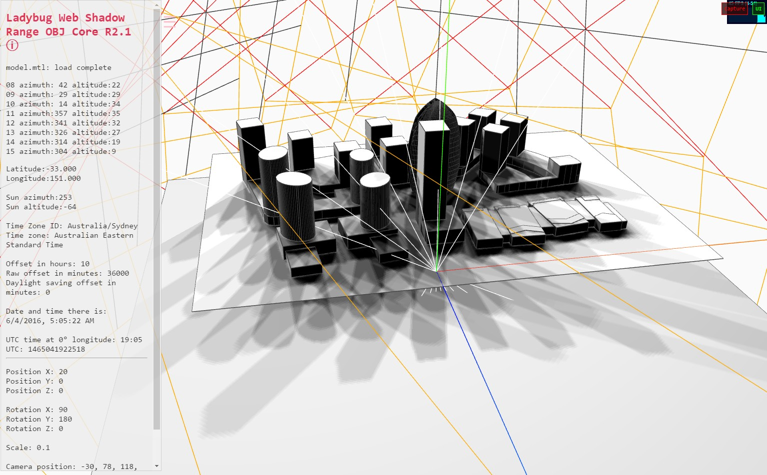
Shadow Range Calcs & More
Let the sun shine in...
Notes:
Live demo if possible
A typical application of a Solar calculator is to show the shadows cast over the course of a day

Slide 48
Outline:
Examples (25 min)
Mostapha :: epwmap
Matt :: epwvis
Chris :: Payette Thermal Comfort Tool
Theo :: ladybug-web
Workshop (40 min)
Choosing a language for your project
Closing & Questions (10 min)

Slide 49
Choosing a language for your project
I want to:
Simple stuff, e.g. parse a bunch of files → Python, Ruby
Execute a bunch of commands → Bash/Shell script
Write an OpenStudio measure → Ruby OpenStudio API
Write a web application → Javascript, CSS, PHP, Python, Ruby
Make a web visualization → d3.js (javascript)
Make a 3D web visualization → three.js (javascript)
Work with applications (e.g. Revit, Unity) → C#, Visual Basic .Net
Run a bunch of statistics on my data → R, Python with pandas package
Do lots matrix calculations → C++
Write Apps for smartphones → Objective-C, Java, C++

Slide 50
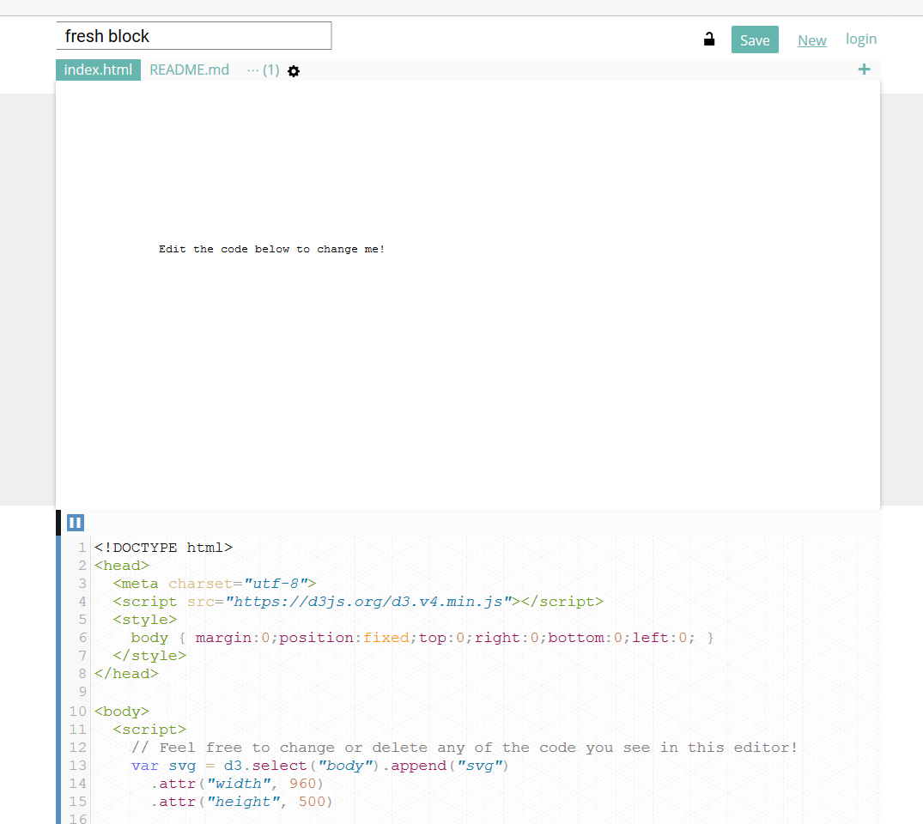
Workshop (40 min)
Get out your computers and follow along!
Topics:
Basic data binding
Exporting and using data in .json format
Calculations with .json data
Overlaying data on 3D objects
http://blockbuilder.org/

Slide 51
Outline:
Examples (25 min)
Mostapha :: epwmap
Matt :: epwvis
Chris :: Payette Thermal Comfort Tool
Theo :: ladybug-web
Workshop (40 min)
Choosing a language for your project
Closing & Questions (10 min)

Slide 52
Questions?
Online Resources:
Most popular programming languages:
http://www.tiobe.com/tiobe_index
http://githut.info/
***Just because a language is popular doesn’t mean it is a good fit for your task!!!
Programmer competency matrix:
http://sijinjoseph.com/programmer-competency-matrix/
Programming resources:
https://wiki.lesswrong.com/wiki/Programming_resources
Google

Slide 53
Bio::Mostapha Roudsari
Mostapha Sadeghipour Roudsari is a designer, software developer, and an educator focused on the integration of parametric environmental analysis and architectural design. He is the creator of the well-known open source environmental plugins Ladybug, Honeybee, and Butterfly and web applications such as epwmap and Pollination. He lectures and teaches seminars frequently throughout Architecture and Engineering schools, the AEC community, and as a lecturer at the University of Pennsylvania.

Slide 54
Bio::Mathew Dahlhausen
Matthew Dahlhausen is an Energy Modeler with Integral Group, Inc. He is the team's expert on OpenStudio, parametric modeling, scripting, data analysis, and data visualization with web tools. In addition to his work, he is pursuing his doctorate in Mechanical Engineering at the University of Maryland, focusing on building energy model calibration. He holds an M.S. in Architectural Engineering from Penn State, and a B.E. in Environmental Engineering from Dartmouth College. He has authored or co-authored several papers in the field.

Slide 55
Bio::Chris Mackey
Chris has worked as a Building Scientist at Payette Architects since 2015 after finishing both his Masters of Architecture and Masters of Science in Building Technology at MIT. He is one of the primary developers of the Ladybug + Honeybee environmental analysis plugins for Rhino/Grasshopper, which are regularly applied at Payette and across the globe by a community of over 70,000 people.

Slide 56
Bio::Theo Armour
Theo was awarded a BA from Syracuse University in New York and an AADip - equivalent to an MS - from the Architectural Association in London. He has been a licensed architect - and practiced in the UK renovating houses and in Hong Kong designing twelve underground mass transit stations.
While working at Autodesk for ten years, he was program manager for three releases of AutoCAD - the market leading application for computer aided design.
He is currently an angel investor and technical mentor for a number of startups. He is a software developer who makes extensive use of the Three.js JavaScript library. He is a maintainer of the Three.js and WebGL subreddits at www.reddit.com. He is a principal author of the Three.js Wikipedia entry.

